Slide 1
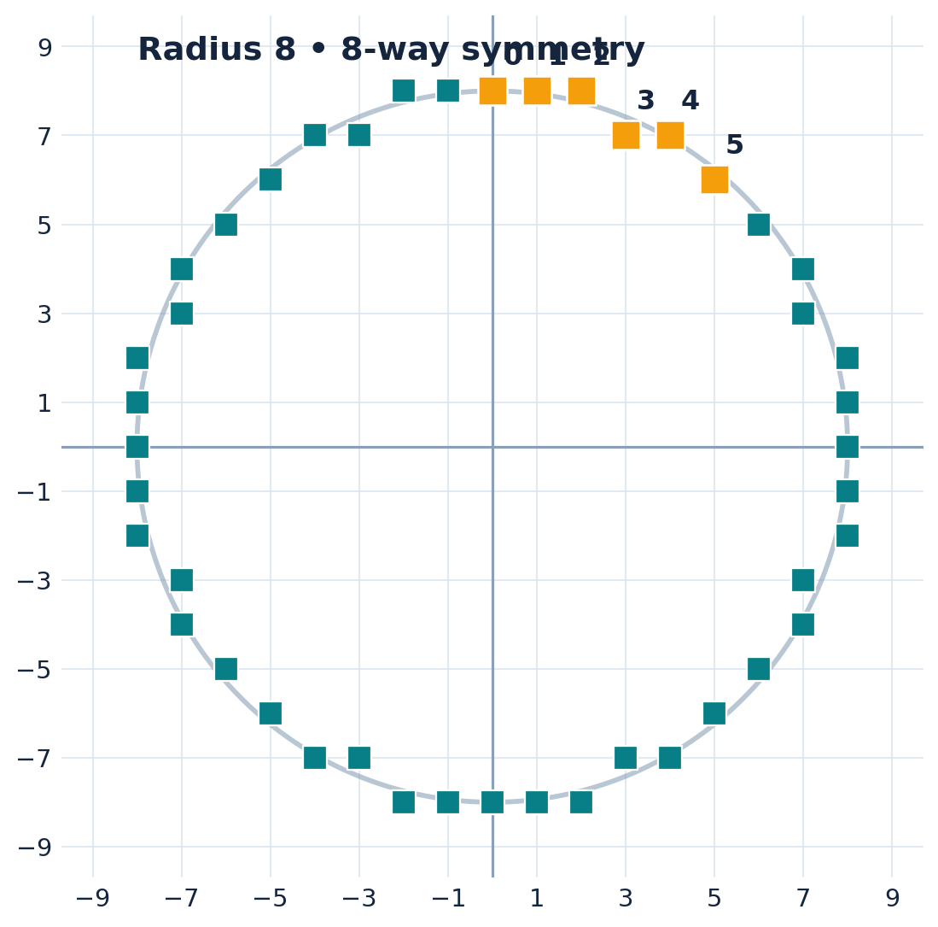
COMPUTER GRAPHICS • CSC 4118
Midpoint Circle
Algorithm
Complete theory, derivations, decision tables, and OpenGL laboratory implementation
FALL 2026–2027 | INSTRUCTOR PRESENTATION
Notes:
Title | Instructor opening
Begin by showing a circle on a screen and asking students how a computer chooses which discrete pixels should be illuminated. State that the aim of the lecture is to derive an integer decision rule, compute one eighth of the circle, and reflect it using symmetry. This lesson follows the provided Chapter 2 Part 2 lecture (Bresenham’s Mid Point Circle Algorithm) and CG Lab Manual 4, with additional fully worked explanations.

Slide 2
LEARNING OUTCOMES / CSC 4118
What you will learn
Students should be able to derive, calculate, draw, and implement the algorithm.
01
Explain pixel-based circle rasterization
02
Use 8-way symmetry to complete a circle
03
Derive d₀, E, and SE decision updates
04
Perform a full numerical trace for a given radius
05
Draw a circle with a non-origin center
06
Implement the method in OpenGL/FreeGLUT
MIDPOINT CIRCLE ALGORITHM • FALL 2026–27
2
Notes:
Learning outcomes
Tell students the examination component includes writing the midpoint circle algorithm, computing decision values and plotted coordinates, and explaining symmetry. The lab component requires drawing circles using the midpoint updates in C++ OpenGL/FreeGLUT. Clarify that the midpoint LINE algorithm learned earlier is different: the circle uses E and SE moves, not E and NE.

Slide 3
LESSON MAP / CSC 4118
The big picture: one small arc becomes a full circle
Five connected ideas, from geometry to code.
01
02
03
04
05
Circle equation
Choose an octant
Test the midpoint
Update E / SE
Reflect & plot
→
→
→
→
x² + y² = r²
x = 0, y = r
d < 0 or d ≥ 0
new point + new d
8-way symmetry
At every iteration: plot current pixel → test d_old → select E or SE → calculate d_new → repeat
MIDPOINT CIRCLE ALGORITHM • FALL 2026–27
3
Notes:
Lesson map
Repeat the fundamental loop aloud. Highlight that each d_new is carried forward as d_old in the next iteration. The algorithm performs a small amount of work for each calculated octant point; eight-way symmetry generates the full circle.

Slide 4
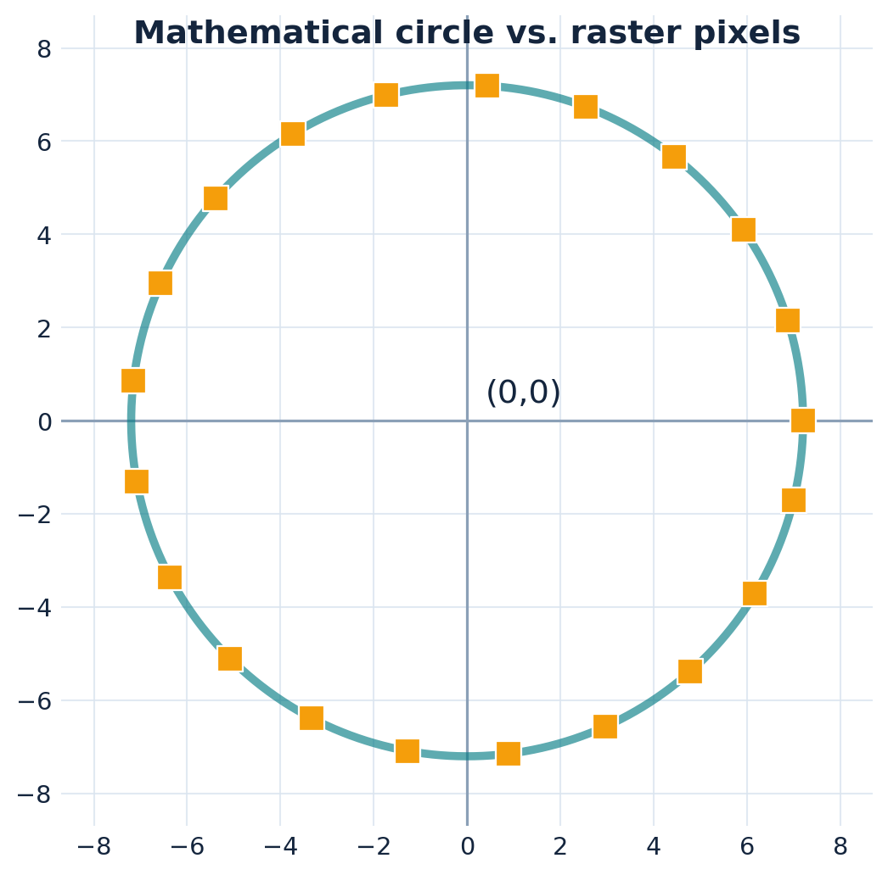
FOUNDATION / CSC 4118
Begin with the equation of a circle
The center and radius define the ideal mathematical circumference.
x² + y² = r²
Circle centered at (0,0)
(X − xc)² + (Y − yc)² = r²
Circle centered at (xc,yc)
MIDPOINT CIRCLE ALGORITHM • FALL 2026–27
4
Notes:
Circle equation
Draw a circle centered at the origin. Remind students that r measures distance from center to any point on the ideal circumference. The equation for general center is (X-xc)^2+(Y-yc)^2=r^2, but for rasterization we work in local coordinates about origin and translate at the plotting stage.

Slide 5
MOTIVATION / CSC 4118
Why not calculate every y using a square root?
The direct equation is intuitive, but repeats expensive calculations.
A direct calculation
Midpoint Circle Algorithm
y = √(r² − x²)
No repeated square roots
Compute y for each x
Uses an integer-like decision value
Round to the nearest pixel
Calculates only one octant
Repeat across the circle
Reflects points with symmetry
Historical advantage: small integer updates make pixel selection efficient.
MIDPOINT CIRCLE ALGORITHM • FALL 2026–27
5
Notes:
Motivation
Students may know the rearranged circle equation y = sqrt(r^2-x^2). Explain that direct evaluation has repeated square roots and rounding, whereas a midpoint error function can be updated by simple additions. Modern graphics devices do much more, but this classic method makes the rasterization principle transparent.

Slide 6
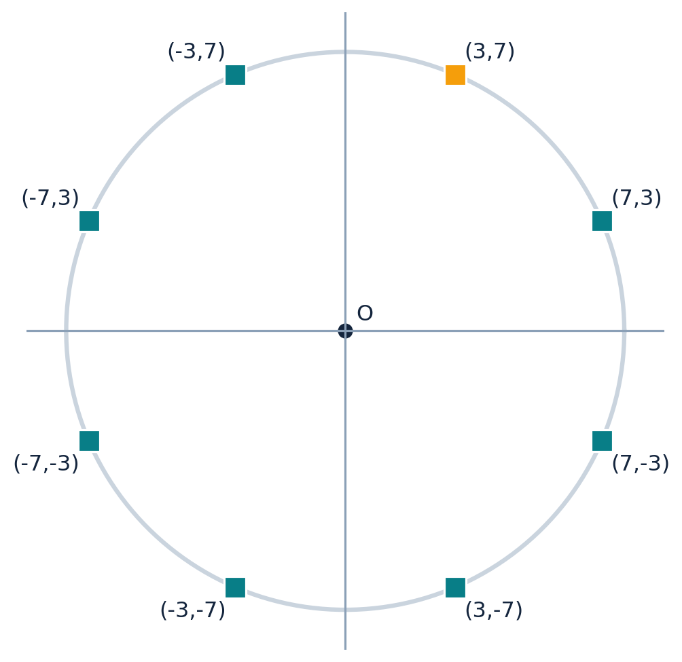
SYMMETRY / CSC 4118
Eight-way symmetry: one point gives eight
All sign changes and coordinate swaps are symmetrical around the center.
From one local point (x,y)
( x, y)
( y, x)
(−x, y)
(−y, x)
(−x, −y)
(−y, −x)
( x, −y)
( y, −x)
MIDPOINT CIRCLE ALGORITHM • FALL 2026–27
6
Notes:
Eight-way symmetry
Explain the mirror lines x=0, y=0, y=x, and y=-x. Show how (3,7) creates (7,3), (-3,7), etc. Students should explicitly write all eight cases because this is often omitted in code. Note that at axes or the diagonal some formulas duplicate the same pixel. The full circle needs no separate calculation of each octant.

Slide 7
SYMMETRY / CSC 4118
How to draw a circle around a different center
The algorithm calculates local coordinates; plotting adds (xc,yc).
X = xc + x
Worked translation
Translate the calculated local x
Center C = (20, 30)
Local point P = (3, 7)
Y = yc + y
Translated P = (23, 37)
Translate the calculated local y
Repeat for the other seven reflections
The decision formula still uses only the local x, y, and radius.
MIDPOINT CIRCLE ALGORITHM • FALL 2026–27
7
Notes:
Center translation
A circle centered at (20,30) does not require a new derivation. Obtain local points first, then add xc and yc during plotting. One local point (3,7) gives (23,37) and the remaining seven coordinates are obtained using the eight symmetry formula with appropriate signs and coordinate swaps.

Slide 8
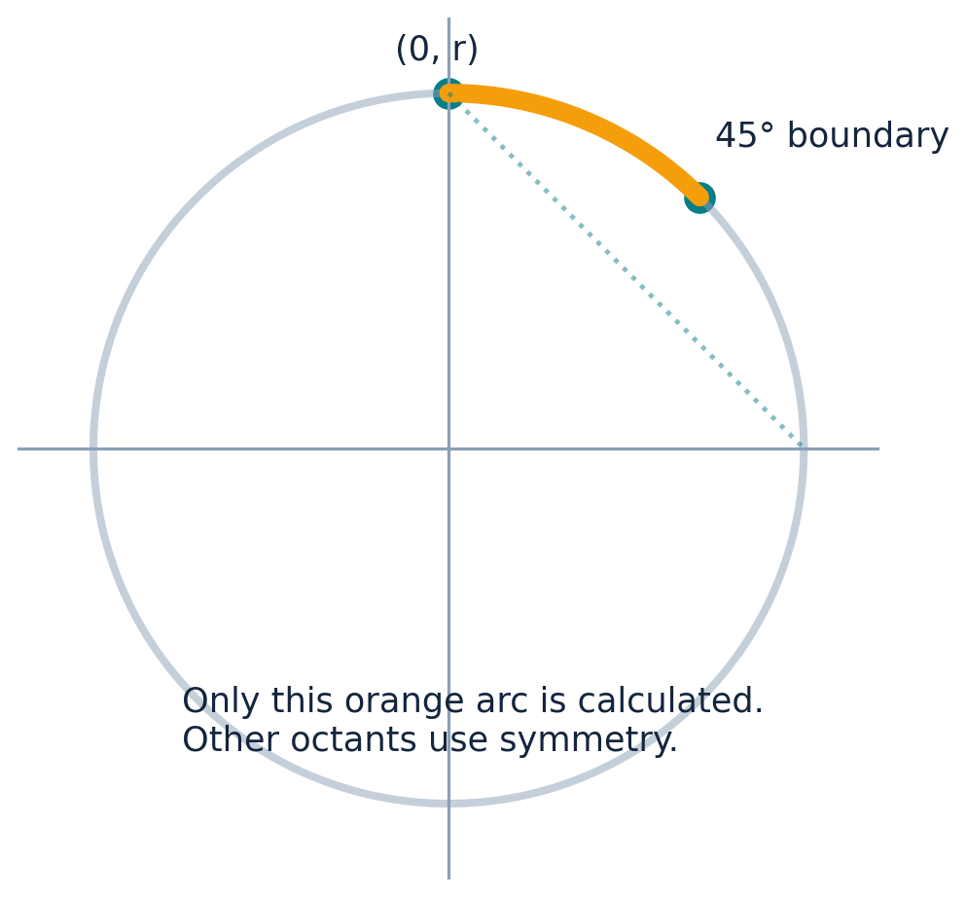
OCTANT / CSC 4118
Compute only one octant
Start at the top and move toward the 45° diagonal.
Initialize local coordinates
x = 0, y = r
At each move:
x always increases by 1
y remains or decreases by 1
plot while x ≤ y
MIDPOINT CIRCLE ALGORITHM • FALL 2026–27
8
Notes:
First octant and stop
The calculated octant is the short arc in quadrant one between 90 degrees and 45 degrees. Start at x=0, y=r; x increases each iteration, and y stays fixed or decreases by one. While x<=y, the point belongs to the octant. At x>y, stop: swapping coordinates would repeat the mirrored portion. A standard implementation tests while (x <= y), plots, updates, and checks the condition again.

Slide 9
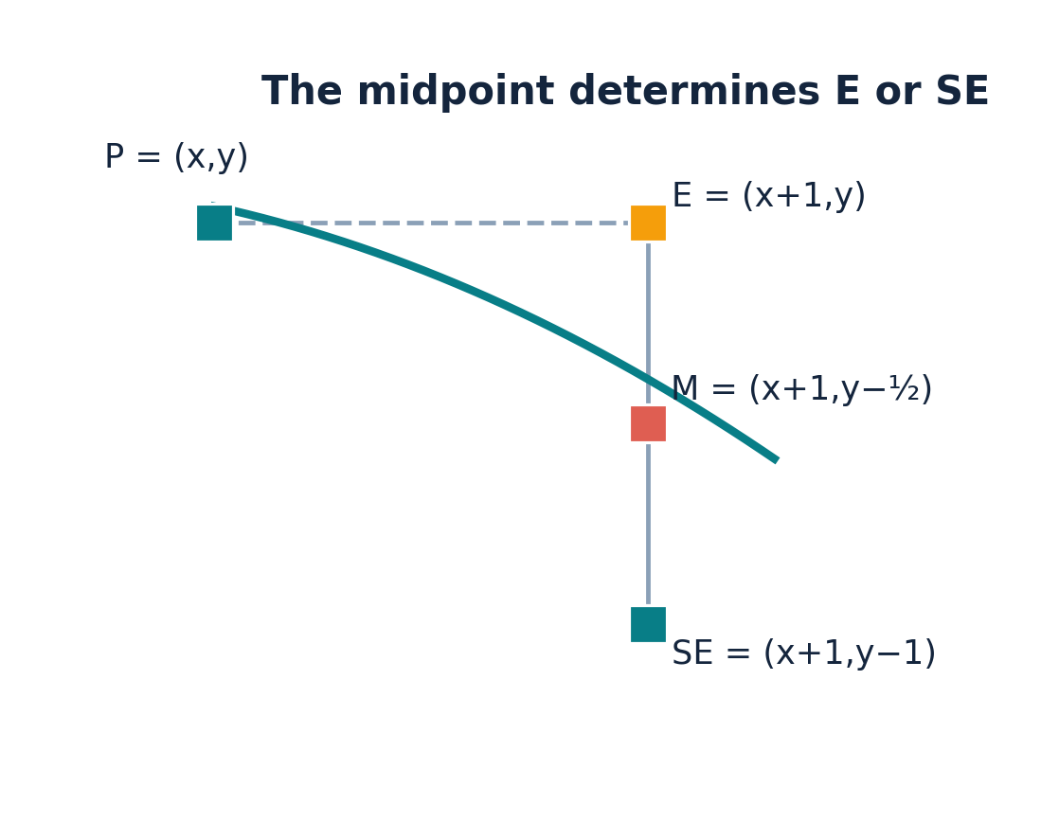
MIDPOINT DECISION / CSC 4118
At each iteration, two candidate pixels
Circle rasterization chooses East (E) or South-East (SE).
E = (x + 1, y)
x rises; y stays
SE = (x + 1, y − 1)
x rises; y falls
Unlike Midpoint Line, the circle uses E / SE.
MIDPOINT CIRCLE ALGORITHM • FALL 2026–27
9
Notes:
Candidate pixels
Show a current point on the top-right arc. The next candidate pixel to the right is E=(x+1,y). A second candidate one row lower is SE=(x+1,y-1). As x increases along this arc, y cannot increase. Explain the contrast with the shallow-slope midpoint LINE algorithm, where candidates are E and NE.

Slide 10
MIDPOINT DECISION / CSC 4118
Find the midpoint M between E and SE
The midpoint lies halfway vertically between the candidates.
E = (x + 1, y)
SE = (x + 1, y − 1)
M = (x + 1, (2y − 1) / 2)
M = (x + 1, y − ½)
We test M, not E and SE separately.
MIDPOINT CIRCLE ALGORITHM • FALL 2026–27
10
Notes:
Midpoint coordinates
Write E=(x+1,y) and SE=(x+1,y-1). Average each coordinate: x remains x+1; the average y is (y+(y-1))/2 = y-1/2. This negative half is crucial; for the midpoint LINE algorithm they previously used y+1/2 because E and NE are considered.

Slide 11
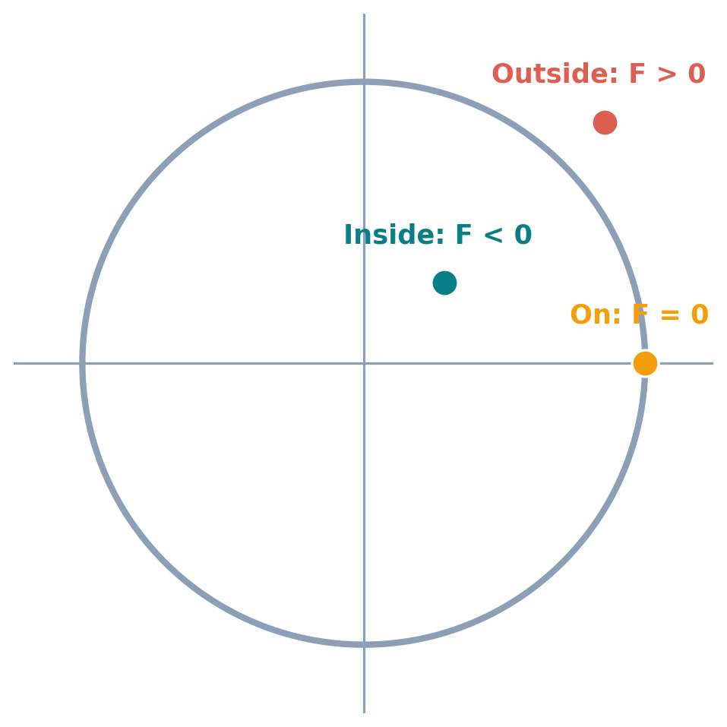
MIDPOINT DECISION / CSC 4118
Use an implicit circle function
The sign of F(M) tells whether the midpoint is inside or outside.
F(x,y) = x² + y² − r²
Derived from x² + y² = r²
F(M) < 0 → inside circle
F(M) = 0 → on circle
F(M) > 0 → outside circle
MIDPOINT CIRCLE ALGORITHM • FALL 2026–27
11
Notes:
Circle function sign
Because x^2+y^2 compares the squared distance from the origin to r^2, F(x,y)<0 is inside, F>0 is outside, and F=0 is exactly on. The midpoint error value d=F(M) will decide whether the circumferential boundary is above/outside the midpoint or below/inside.

Slide 12
MIDPOINT DECISION / CSC 4118
Decision rule: how to choose E or SE
At the same next x, the circle can pass above or below the midpoint.
MIDPOINT INSIDE
MIDPOINT ON / OUTSIDE
d < 0
d ≥ 0
Choose E → (x + 1, y)
Choose SE → (x + 1, y − 1)
Tie case: when d = 0, this course convention chooses SE.
MIDPOINT CIRCLE ALGORITHM • FALL 2026–27
12
Notes:
Decision rule
Teach the exact source convention: d<0 selects E; d>=0 selects SE. The tie d=0 therefore chooses SE. Explain this by noting that the ideal curve lies outside the interior midpoint and thus E approximates it better when d<0; when the midpoint is on or outside, select the lower candidate SE.

Slide 13
DERIVATION / CSC 4118
Derive the initial midpoint decision
Start at (0, r); substitute the first midpoint into F.
x₀ = 0, y₀ = r
Exact midpoint initialization
M₀ = (1, r − ½)
d₀ = 5/4 − r
d₀ = F(1, r − ½)
d₀ = 1 + (r − ½)² − r²
d₀ = 1 + (r² − r + ¼) − r²
This matches the lab manual.
d₀ = 5/4 − r
MIDPOINT CIRCLE ALGORITHM • FALL 2026–27
13
Notes:
Derive exact d0
The first local pixel is (0,r). The next candidates are (1,r) and (1,r-1), so their midpoint is (1,r-1/2). Substituting into F(x,y)=x^2+y^2-r^2 gives 1+(r-1/2)^2-r^2. Expand the square to obtain 1+r^2-r+1/4-r^2 = 5/4-r. This exact form is written in the uploaded CG Lab Manual 4. Students should see each cancellation.

Slide 14
DERIVATION / CSC 4118
Why the lecture also uses d₀ = 1 − r
The integer-friendly convention differs by a constant quarter.
Lab manual: exact form
Lecture: integer form
d₀ = 5/4 − r
d₀ = 1 − r
For integer radii, both yield the same E/SE sequence with our tie rule; use 1 − r in hand calculations.
MIDPOINT CIRCLE ALGORITHM • FALL 2026–27
14
Notes:
Initialization conventions
Distinguish source conventions explicitly rather than claiming 5/4-r and 1-r are algebraically equal. The lab manual states 5/4-r. The theory slides replace 5/4 with 1 for a convenient integer decision value. Each subsequent difference in the midpoint decision is integer. Therefore the exact decision values have fractional part 1/4, and the shifted integer values have fractional part 0; signs and tie behavior coincide for integer radii and coordinates when integer d=0 means SE. We use d0=1-r for the rest of these examples.

Slide 15
DERIVATION / CSC 4118
Derive the update when E is selected
Old coordinates are (x, y); East moves only one step right.
M_old = (x + 1, y − ½)
IF d_old < 0
M_new = (x + 2, y − ½)
Choose E
d_new − d_old = F(M_new) − F(M_old)
d_new = d_old + 2x_old + 3
= (x + 2)² − (x + 1)²
= (x² + 4x + 4) − (x² + 2x + 1)
= 2x + 3
Then: x += 1; y stays.
MIDPOINT CIRCLE ALGORITHM • FALL 2026–27
15
Notes:
E update derivation
Old midpoint is (x+1,y-1/2). If E is chosen, new pixel is (x+1,y), so next midpoint is (x+2,y-1/2). Subtract F at old midpoint from F at new midpoint; y terms and -r^2 cancel. Only x terms remain: (x+2)^2-(x+1)^2=2x+3. Using old coordinates, d_new=d_old+2x_old+3. Critically, update d BEFORE overwriting x if using old-coordinate form.

Slide 16
DERIVATION / CSC 4118
Derive the update when SE is selected
South-East moves right by 1 and down by 1.
M_old = (x + 1, y − ½)
IF d_old ≥ 0
M_new = (x + 2, y − 3/2)
Choose SE
d_new − d_old = F(M_new) − F(M_old)
= [(x + 2)² − (x + 1)²]
d_new = d_old + 2(x_old − y_old) + 5
+ [(y − 3/2)² − (y − ½)²]
= (2x + 3) + (−2y + 2)
= 2(x − y) + 5
Then: x += 1; y -= 1.
MIDPOINT CIRCLE ALGORITHM • FALL 2026–27
16
Notes:
SE update derivation
If SE is selected, the new pixel is (x+1,y-1). The next midpoint is (x+2,y-3/2), one column right and one row down from the previous midpoint. Subtract implicit circle function values. The x-square difference is 2x+3. The y-square difference is (y-3/2)^2-(y-1/2)^2=-2y+2. Sum is 2x-2y+5. Hence d_new=d_old+2(x_old-y_old)+5. Emphasize that the two coordinates in this formula are the old current pixel.

Slide 17
FORMULA SHEET / CSC 4118
The full mathematical algorithm in one table
Use this exact convention for class exercises and exams.
Condition | Which pixel? | New local coordinates | New decision parameter
Start | Top point | (0, r) | d₀ = 1 − r
d_old < 0 | E | (x + 1, y) | d_new = d_old + 2x_old + 3
d_old ≥ 0 | SE | (x + 1, y − 1) | d_new = d_old + 2(x_old − y_old) + 5
Carry-forward rule: d_new in this row is d_old in the next row.
MIDPOINT CIRCLE ALGORITHM • FALL 2026–27
17
Notes:
Formula summary
Pause and ask each student to copy the decision table. Say: initialize x=0,y=r,d=1-r. First plot the eight symmetric pixels. If d<0 choose E, add 2*x_old+3; otherwise choose SE, add 2*(x_old-y_old)+5. Update x/y accordingly. Continue until x>y. Every new decision value becomes the old value for the next row.

Slide 18
COMMON CONFUSION / CSC 4118
Old-coordinate vs new-coordinate forms
Both formula sets are correct—do not mix them within one calculation.
Use OLD x and y before moving
Use NEW x and y after moving
E: d_new = d_old + 2x_old + 3
E: d_new = d_old + 2x_new + 1
SE: d_new = d_old + 2(x_old − y_old) + 5
SE: d_new = d_old + 2x_new + 1 − 2y_new
MIDPOINT CIRCLE ALGORITHM • FALL 2026–27
18
Notes:
Old/new coordinate equivalence
This resolves a common confusion between the slide derivation and the lab manual algorithm. For E, x_new=x_old+1; substituting into 2x_old+3 yields 2x_new+1. For SE, x_new=x_old+1 and y_new=y_old-1; 2(x_old-y_old)+5 equals 2x_new+1-2y_new. Both are mathematically equivalent, but mixing one branch in old coordinates with another branch mistakenly evaluated after updates causes wrong decision sequences. We will use old coordinates in worked examples.

Slide 19
CONTROL FLOW / CSC 4118
When do we stop calculating points?
Do not continue beyond the 45° diagonal.
Loop condition
while (x ≤ y)
Plot current point first
Update E or SE
If the updated x > y, stop
MIDPOINT CIRCLE ALGORITHM • FALL 2026–27
19
Notes:
Stopping criterion
We cover the octant from x=0,y=r toward x=y. When x>y, points lie beyond the symmetry boundary and would duplicate counterparts found by swapping x and y. Code naturally expresses this as while(x<=y), plot8, choose E/SE, update. With r=8, the final plotted octant point is (5,6); the next candidate (6,5) lies past the boundary, so it is not plotted in this chosen loop convention.

Slide 20
ALGORITHM / CSC 4118
Theory-exam algorithm: complete pseudocode
Students should be able to write these steps without C++ syntax.
INPUT center (xc, yc), radius r
x ← 0; y ← r; d ← 1 − r
WHILE x ≤ y:
Plot eight symmetric points (xc,yc,x,y)
IF d < 0: // E
d ← d + 2*x + 3
ELSE: // SE
d ← d + 2*(x − y) + 5
y ← y − 1
x ← x + 1
Plot before updating
Decision uses current d
d_new carries forward
Stop after x > y
MIDPOINT CIRCLE ALGORITHM • FALL 2026–27
20
Notes:
Exam pseudocode
Do not require students to reproduce a particular C++ syntax if the question requests mathematical algorithm steps. Give credit for correct initialization, symmetry, d sign branch, correct E/SE decision update, coordinate updates, and termination. The ordering here is deliberately written for old coordinates: update d before x/y within each branch, and increase x at the end.

Slide 21
ALGORITHM / CSC 4118
Exactly what happens in one iteration
Follow the same sequence every time.
1 · CURRENT
2 · CHOOSE
3 · UPDATE
Current pixel (x, y)
→
d < 0 → E
→
Compute d_new
Decision d_old
d ≥ 0 → SE
Move to next pixel
DO NOT restart d from 1 − r at each step.
MIDPOINT CIRCLE ALGORITHM • FALL 2026–27
21
Notes:
Iteration routine
At each row, current x,y,d are already known from the previous row. First plot symmetry points for current (x,y). Check the sign of d. If d<0 select E and compute d_new=d_old+2*x_old+3; otherwise select SE and compute d_new=d_old+2*(x_old-y_old)+5. Move x, and y if needed. Write d_new as the next row’s d_old. Repeat until the octant condition fails.

Slide 22
WORKED EXAMPLE / CSC 4118
Worked mathematics: draw a circle of radius 8
Fresh numerical example with every calculation shown.
Given: center = (0, 0), r = 8
x₀ = 0, y₀ = 8
d₀ = 1 − r = 1 − 8
d₀ = −7
Plot (0, 8) and its symmetric points
MIDPOINT CIRCLE ALGORITHM • FALL 2026–27
22
Notes:
Worked example r8 initialization
Work on the board from radius 8: start (0,8) and d0=1-8=-7. Plot the top point and its seven reflections (some duplicate because x=0). Tell students the first decision tests d=-7 and will select E. Keep a table with columns current point, d_old, choice, arithmetic, new point, d_new.

Slide 23
WORKED EXAMPLE / CSC 4118
Radius 8: calculate iterations 1 and 2
Each newly calculated decision becomes the next old decision.
ITERATION 1
ITERATION 2
Current: (0,8), d_old = −7
Current: (1,8), d_old = −4
d < 0 → choose E
d < 0 → choose E
New pixel = (1,8)
New pixel = (2,8)
d_new = −7 + 2(0) + 3 = −4
d_new = −4 + 2(1) + 3 = 1
MIDPOINT CIRCLE ALGORITHM • FALL 2026–27
23
Notes:
R8 first two iterations
Explain why the second row starts with d_old=-4, not d0=-7. Iteration 1 at (0,8): d=-7<0, E, next (1,8), new d=-7+2*0+3=-4. Iteration 2 at (1,8): d=-4<0, E, next (2,8), new d=-4+2*1+3=1. Mark both selected current pixels on a drawn grid.

Slide 24
WORKED EXAMPLE / CSC 4118
Radius 8: calculate iterations 3 and 4
The first SE decision happens when d turns positive.
ITERATION 3
ITERATION 4
Current: (2,8), d_old = 1
Current: (3,7), d_old = −6
d ≥ 0 → choose SE
d < 0 → choose E
New pixel = (3,7)
New pixel = (4,7)
d_new = 1 + 2(2−8) + 5
d_new = −6 + 2(3) + 3
= 1 − 12 + 5 = −6
= −6 + 6 + 3 = 3
MIDPOINT CIRCLE ALGORITHM • FALL 2026–27
24
Notes:
R8 iterations 3 and 4
Iteration 3: d_old=1>0 at (2,8), choose SE. New point (3,7). To update d use OLD point (2,8), so d_new=1+2*(2-8)+5=-6. Do not accidentally use (3,7) inside the old-coordinate formula. Iteration 4: point (3,7), d_old=-6, E -> (4,7); d_new=-6+2*3+3=3.

Slide 25
WORKED EXAMPLE / CSC 4118
Radius 8: finish iterations 5 and 6
Stop after the next candidate passes the diagonal.
ITERATION 5
ITERATION 6
Current: (4,7), d_old = 3
Current: (5,6), d_old = 2
d ≥ 0 → choose SE
d ≥ 0 → choose SE
Next pixel = (5,6)
Candidate = (6,5)
d_new = 3 + 2(4−7) + 5
d_new = 2 + 2(5−6) + 5 = 5
= 3 − 6 + 5 = 2
STOP: 6 > 5
MIDPOINT CIRCLE ALGORITHM • FALL 2026–27
25
Notes:
R8 finishing the octant
Iteration 5 from (4,7): d_old=3, SE -> (5,6), new d=3+2*(4-7)+5=2. Iteration 6 from (5,6): d_old=2, SE -> prospective (6,5), new d=2+2*(5-6)+5=5. Since the candidate has x=6>y=5, the while condition fails on the next check, so (6,5) is not plotted as an additional calculated-octant point. The circle is already complete by reflection.

Slide 26
WORKED EXAMPLE / CSC 4118
Radius 8: complete iteration table
Check each d_old, selected branch, and carry-forward d_new.
Current point | d_old | Decision | Next candidate | Arithmetic for d_new | d_new
(0,8) | −7 | E | (1,8) | −7 + 2(0) + 3 | −4
(1,8) | −4 | E | (2,8) | −4 + 2(1) + 3 | 1
(2,8) | 1 | SE | (3,7) | 1 + 2(2−8) + 5 | −6
(3,7) | −6 | E | (4,7) | −6 + 2(3) + 3 | 3
(4,7) | 3 | SE | (5,6) | 3 + 2(4−7) + 5 | 2
(5,6) | 2 | SE | (6,5) | 2 + 2(5−6) + 5 | 5
Plotted octant points: (0,8), (1,8), (2,8), (3,7), (4,7), (5,6)
MIDPOINT CIRCLE ALGORITHM • FALL 2026–27
26
Notes:
R8 complete table
Review all rows from left to right. The current point in a row is the point being plotted. The next candidate enters the NEXT row only if its x<=y. Distinguish the final unplotted candidate (6,5) from the six valid plotted points. The d_new of a row is the next row’s d_old, except the final d_new is not needed because the loop ends.

Slide 27
WORKED EXAMPLE / CSC 4118
Radius 8: one octant gives the full circle
Apply the eight symmetry formulas to each of the six calculated points.
First-octant points
(0,8) (1,8) (2,8)
(3,7) (4,7) (5,6)
Example: (3,7) also generates (7,3), (−3,7), ...
MIDPOINT CIRCLE ALGORITHM • FALL 2026–27
27
Notes:
R8 reflection visualization
The orange points represent only the calculated octant. Teal points are generated from the eight symmetry expressions. For each valid pair (x,y), call plot8(xc,yc,x,y), where the center is (0,0) for this example. Note that at x=0 duplicates occur when switching signs; implementations may plot the same pixel more than once, which is harmless.

Slide 28
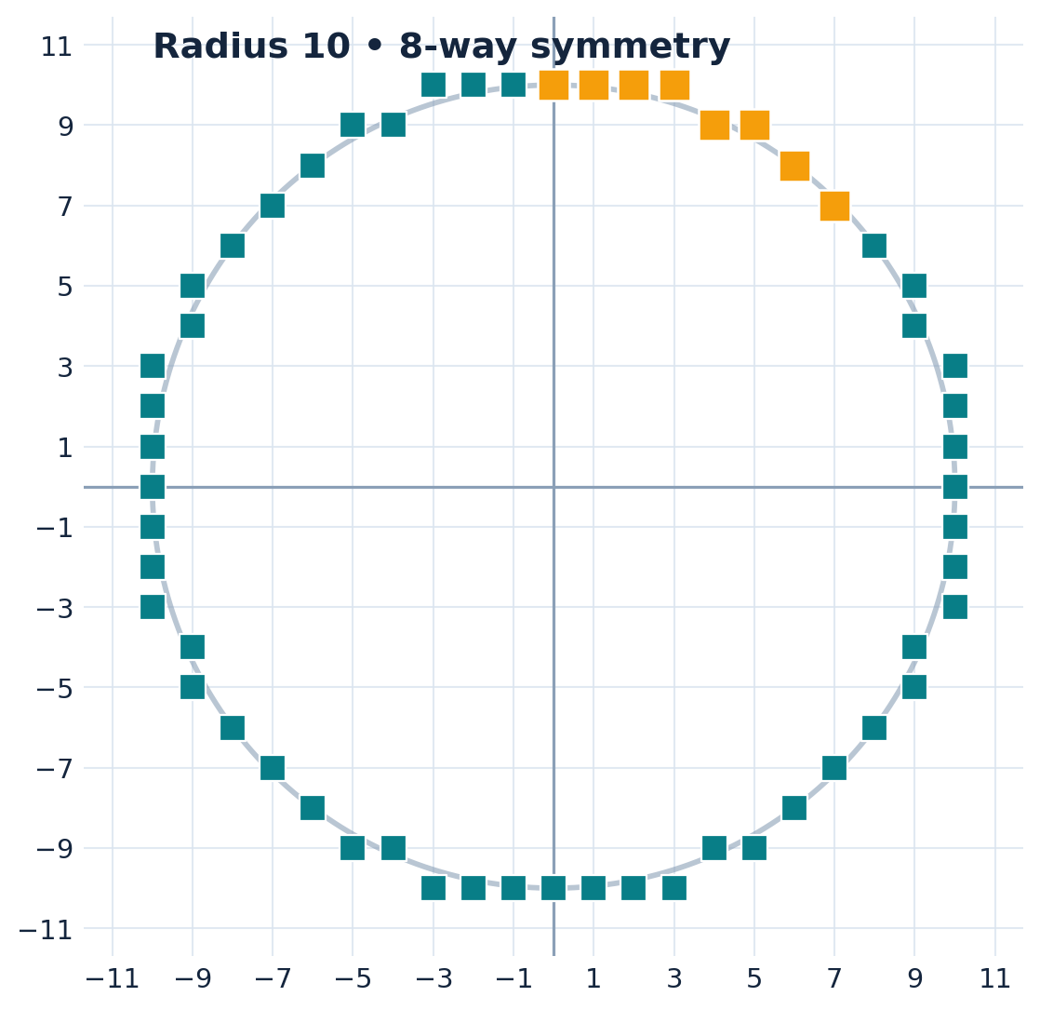
SOURCE EXAMPLE / CSC 4118
Source-style example: radius 10
This follows the radius-10 approach shown in your uploaded theory lecture.
Initialization
r = 10, (x,y) = (0,10), d₀ = −9
Calculated local pixels
(0,10), (1,10), (2,10),
(3,10), (4,9), (5,9),
(6,8), (7,7)
MIDPOINT CIRCLE ALGORITHM • FALL 2026–27
28
Notes:
Source radius 10 example
The supplied Chapter 2 Part 2 slides show radius-10 local points (1,10),(2,10),(3,10),(4,9),(5,9),(6,8),(7,7); the starting pixel (0,10) is also part of the algorithm. The decision values are -9,-6,-1,6,-3,8,5,6 for the current points. After each step use the E/SE rule. This slide explicitly stays close to the numerical example in the source.

Slide 29
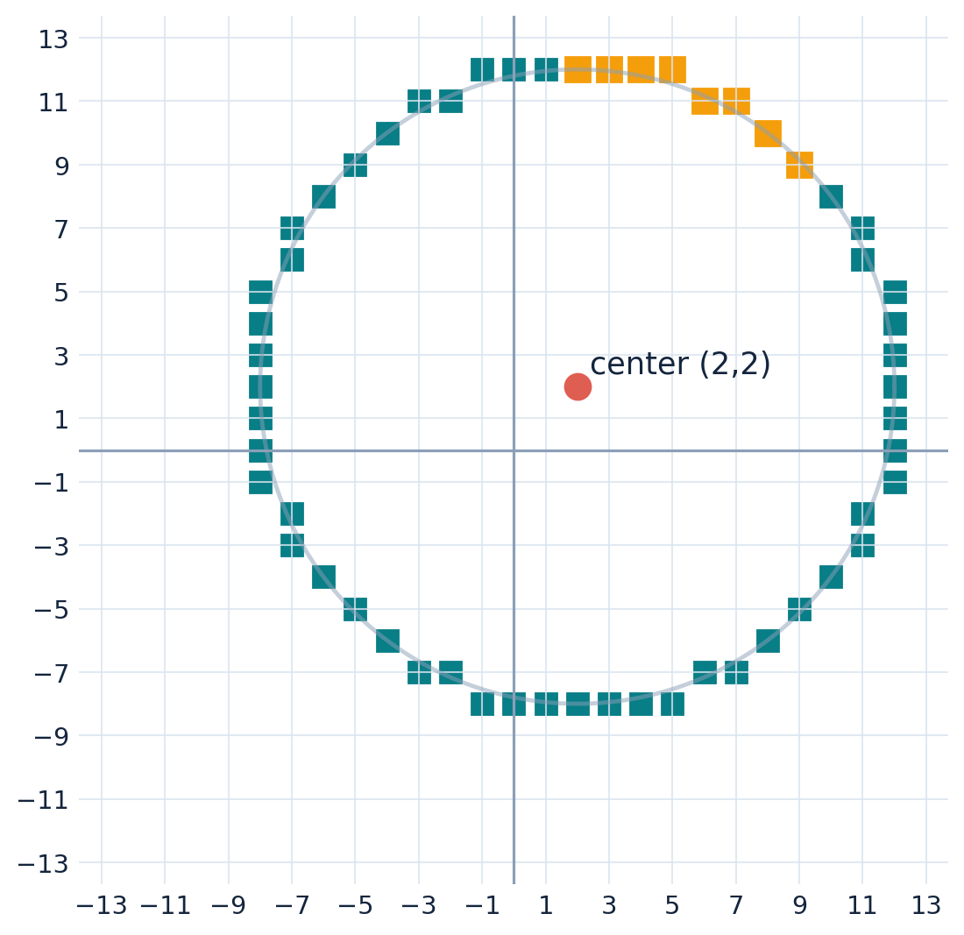
CENTER TRANSLATION / CSC 4118
Shift the radius-10 circle to center (2,2)
First compute local pixels, then translate every symmetric point.
Center C = (2,2)
Local point (3,10)
→ shifted point (5,12)
Local (7,7) → shifted (9,9)
Plot all eight offsets for each local point.
MIDPOINT CIRCLE ALGORITHM • FALL 2026–27
29
Notes:
Nonorigin center example
The source theory lecture’s final translated coordinates match circle center (2,2) and radius 10: local (1,10)->(3,12), (2,10)->(4,12), ... (7,7)->(9,9), in addition to the initial top point (0,10)->(2,12). The diagram shows the complete symmetric circle around (2,2), not only the upper-right octant. Emphasize that d calculations do not change when translating the center.

Slide 30
OPENGL LAB / CSC 4118
The eight-point drawing helper
Plot the same local (x,y) in all symmetric octants.
void plot8(int xc, int yc, int x, int y) {
glVertex2i(xc + x, yc + y);
glVertex2i(xc + y, yc + x);
glVertex2i(xc - x, yc + y);
glVertex2i(xc - y, yc + x);
glVertex2i(xc - x, yc - y);
glVertex2i(xc - y, yc - x);
glVertex2i(xc + x, yc - y);
glVertex2i(xc + y, yc - x);
}
MIDPOINT CIRCLE ALGORITHM • FALL 2026–27
30
Notes:
OpenGL plot8 function
Explain every glVertex2i call as xc ± x or y and yc ± y or x. The center offset is added in each vertex. This helper assumes glBegin(GL_POINTS) has already been called by the caller, so it must not nest glBegin calls. Point size and color may be set in the display function.

Slide 31
OPENGL LAB / CSC 4118
Midpoint circle algorithm in C++
Use old-coordinate decision updates and stop at x > y.
void midpointCircle(int xc, int yc, int r) {
if (r < 0) return;
int x = 0, y = r;
int d = 1 - r;
glBegin(GL_POINTS);
while (x <= y) {
plot8(xc, yc, x, y);
if (d < 0) d += 2*x + 3;
else {
d += 2*(x - y) + 5;
y--;
}
x++;
}
glEnd();
}
1. Plot current point
2. Test d_old
3. Update d
4. Move x/y
5. Repeat
MIDPOINT CIRCLE ALGORITHM • FALL 2026–27
31
Notes:
Core C++ algorithm
Use int x=0,y=r,d=1-r. The while condition implements the octant. On each pass call plot8. Then update d using OLD values and increment x; if SE also decrement y. This form agrees with the old-coordinate formulas derived in the theory segment. Negative radius is not meaningful and is rejected.

Slide 32
OPENGL LAB / CSC 4118
Connect the algorithm to an OpenGL window
The program must initialize GLUT, set the viewing area, and register display.
void display() {
glClear(GL_COLOR_BUFFER_BIT);
glColor3f(0, 0.4f, 0.7f);
glPointSize(3);
midpointCircle(320, 320, 100);
glFlush();
}
void init() {
glClearColor(1, 1, 1, 1);
glMatrixMode(GL_PROJECTION);
glLoadIdentity();
gluOrtho2D(0, 640, 0, 640);
}
Use an 800×600 or 640×640 window and center the circle inside the visible area.
MIDPOINT CIRCLE ALGORITHM • FALL 2026–27
32
Notes:
GLUT context
The slide shows the essential display() and init() functions; the downloadable PowerPoint notes and companion handout contain the complete runnable main() code. Students need glutInit, display mode, window size, glutCreateWindow, display callback registration, and glutMainLoop in main. Remind them to include <GL/glut.h>. The coordinate system gluOrtho2D(0,640,0,640) places origin in lower-left, so center (320,320) is central.

Slide 33
COMPARISON / CSC 4118
Line midpoint vs circle midpoint vs sin/cos
Understanding the differences prevents formula confusion.
Characteristic | Midpoint LINE | Midpoint CIRCLE | Regular sin/cos circle
Candidates | E / NE (shallow slope) | E / SE (top octant) | Sample many angles
Starting decision | 2dy − dx | 1 − r | No midpoint d
Coordinate updates | x+1; y or y+1 | x+1; y or y−1 | xc+r cosθ, yc+r sinθ
Symmetry needed | No | Eight-way | Optional
Main classroom idea | Approximate a line | Approximate a circle | Parametric plotting
MIDPOINT CIRCLE ALGORITHM • FALL 2026–27
33
Notes:
Comparison
Make it very clear that the line algorithm’s decision formula 2dy-dx cannot be applied to a circle. For a circle, candidates are E and SE, and the starting integer decision is 1-r. The straightforward sin/cos method computes parametric points on the circumference and is useful for drawing circles but differs from rasterizing with a midpoint decision.

Slide 34
TROUBLESHOOTING / CSC 4118
Common mistakes — and how to correct them
The six errors most likely to affect exam and lab answers.
Mixing E/NE and E/SE
Using d₀ for every row
Circle: E/SE, not E/NE.
Carry d_new to the next row as d_old.
Using the wrong coordinate version
Forgetting x = 0, y = r
Old-coordinate formula uses old x and y.
Always start at the top of the local circle.
Not reflecting the point
Continuing after x > y
Call the 8-symmetry plot helper.
Stop after the 45° diagonal.
MIDPOINT CIRCLE ALGORITHM • FALL 2026–27
34
Notes:
Mistake correction
Have students explain why the choice for circle is E/SE. Ask one student what d_old is on the second row after finding d_new on the first. If d=0, select SE. If a student uses formulas with new coordinate values before the move, show the equivalent form explicitly instead of simply marking it wrong. Reiterate duplicates at axes and diagonal are harmless.

Slide 35
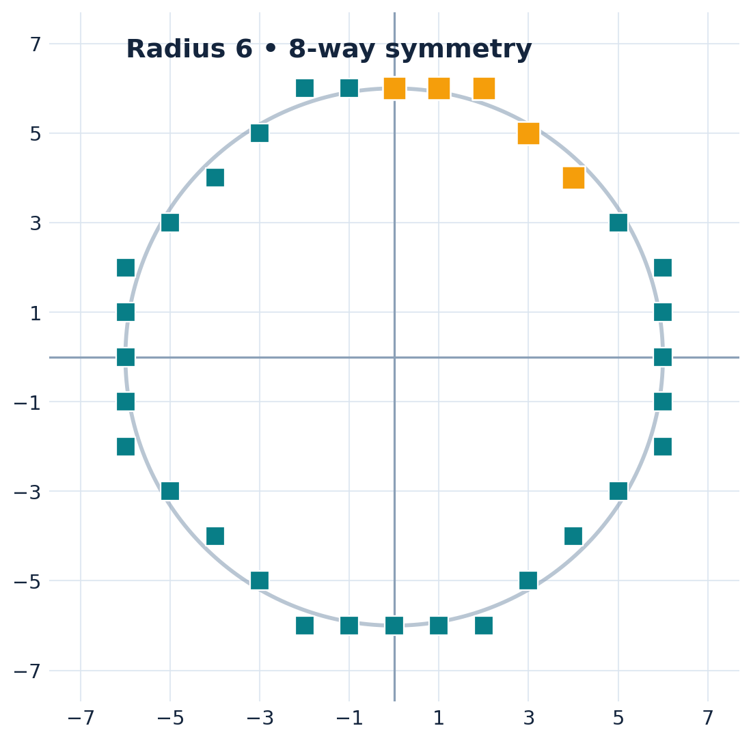
STUDENT PRACTICE / CSC 4118
Guided practice: radius 6
Try the full algorithm independently before revealing the answer.
Question (10 marks)
Center C = (0,0), radius r = 6
Calculate x₀, y₀, and d₀
For each iteration: state E/SE and d_new
List all plotted first-octant pixels
State the stopping condition
Hint: use the decision table, not a square root.
MIDPOINT CIRCLE ALGORITHM • FALL 2026–27
35
Notes:
Student activity r6
Set this as a 10-minute small-group practice. Provide the formula sheet only if needed. Students should calculate d0=1-6=-5; candidate sequence E, E, SE, SE, SE; plotted local points (0,6),(1,6),(2,6),(3,5),(4,4). They should not plot the last candidate (5,3) as another octant point. Suggested scoring: 2 initialization, 5 correct branch/update rows, 2 point list, 1 stopping explanation. Do not reveal the answer slide until students have attempted it.

Slide 36
STUDENT PRACTICE / CSC 4118
Radius 6: instructor solution / answer key
Reveal after students complete the exercise.
Current point | d_old | Choice | Next candidate | d_new
(0,6) | −5 | E | (1,6) | −2
(1,6) | −2 | E | (2,6) | 3
(2,6) | 3 | SE | (3,5) | 0
(3,5) | 0 | SE | (4,4) | 1
(4,4) | 1 | SE | (5,3) | 6 (stop)
Plotted pixels: (0,6), (1,6), (2,6), (3,5), (4,4)
MIDPOINT CIRCLE ALGORITHM • FALL 2026–27
36
Notes:
R6 answer derivation
Initialize d0=-5. At (0,6): E, d=-5+3=-2. At (1,6): E, d=-2+5=3. At (2,6): SE, d=3+2*(2-6)+5=0; next (3,5). At (3,5), d=0 therefore SE, d=0+2*(3-5)+5=1; next (4,4). At (4,4), d=1, SE, d=1+2*(4-4)+5=6; next (5,3) invalid for first octant, so stop. The local plotted points are (0,6),(1,6),(2,6),(3,5),(4,4).

Slide 37
STEP-BY-STEP MATHS / CSC 4118
The missing link: how d_new becomes the next d_old
One decision value flows forward from iteration to iteration.
BEFORE
TEST + UPDATE
NEXT ROW
Current (x,y) = (0,9)
d_old = −8
−8 < 0 → E
d_new = −8 + 2(0) + 3
= −5
Next (x,y) = (1,9)
Next d_old = −5
Carry forward: next row’s d_old = previous row’s d_new.
MIDPOINT CIRCLE ALGORITHM • FALL 2026–27
37
Notes:
The phrase 'd_new becomes the next d_old' is a renaming, not a second calculation. Use r=9. Start d=-8, choose E and add 3 to reach -5. When you begin the next row, copy -5 into its d_old column. Choose E again, add 5 to reach 0. In the next row d_old equals 0, so we take the SE branch. Do not restart from 1-r. Do not use d_new until after selecting the branch based on d_old.

Slide 38
WORKED EXAMPLE / R=9 / CSC 4118
New complete example: circle of radius 9
Use the lecture’s integer initialization d₀ = 1 − r.
GIVEN
WHAT TO DO FIRST
Center C = (0,0)
Radius r = 9
Start (x,y) = (0,9)
Decision d₀ = 1 − 9 = −8
1. Plot (0,9) and symmetric points
2. Check d = −8 < 0
3. Select E → (1,9)
4. Calculate the next decision
Do not divide the circle into 360 angles. Calculate just one octant.
MIDPOINT CIRCLE ALGORITHM • FALL 2026–27
38
Notes:
Show that radius and starting coordinates are all students need to initialize. x0=0, y0=9, d0=1-9=-8. Before continuing plot all eight symmetric positions of (0,9), noting duplicates at the axis. The exact midpoint parameter is 5/4-9=-7.75; both have the same sign, so the first choice is E. We will use the integer convention consistently.

Slide 39
WORKED EXAMPLE / R=9 / CSC 4118
Iterations 1 and 2: two East steps
Apply d_new = d_old + 2x_old + 3.
ITERATION 1
ITERATION 2
Old: (0,9), d_old = −8
−8 < 0 → E
Next: (1,9)
d_new = −8 + 2(0) + 3 = −5
Old: (1,9), d_old = −5
−5 < 0 → E
Next: (2,9)
d_new = −5 + 2(1) + 3 = 0
The new decision is 0. What happens at a tie?
MIDPOINT CIRCLE ALGORITHM • FALL 2026–27
39
Notes:
Iteration 1: current (0,9), d=-8, choose E; new (1,9), updated d=-8+2*0+3=-5. Iteration 2: current (1,9), d=-5, choose E; new (2,9), updated d=-5+2*1+3=0. Stress we use current x=1 in the second arithmetic, not x=2. The next row must start with d_old=0, not -8 and not -5.

Slide 40
WORKED EXAMPLE / R=9 / CSC 4118
Iterations 3 and 4: the d = 0 tie case
Our decision rule is E for d < 0, SE for d ≥ 0.
ITERATION 3 · TIE
ITERATION 4
Old: (2,9), d_old = 0
0 ≥ 0 → SE
Next: (3,8)
d_new = 0 + 2(2−9) + 5 = −9
Old: (3,8), d_old = −9
−9 < 0 → E
Next: (4,8)
d_new = −9 + 2(3) + 3 = 0
When d = 0, choose SE, not E — this is our fixed tie convention.
MIDPOINT CIRCLE ALGORITHM • FALL 2026–27
40
Notes:
Iteration 3 starts at (2,9) with d_old=0. This is NOT negative, so choose SE. New coordinates (3,8). Using old (2,9): d_new=0+2*(2-9)+5=-9. Iteration 4 starts at (3,8), d=-9, E -> (4,8). Update -9+2*3+3=0. State these are two different rows; the tie appears twice.

Slide 41
WORKED EXAMPLE / R=9 / CSC 4118
Iterations 5–7: finish the calculated octant
Use old coordinates, then stop when the next x exceeds y.
ITERATION 5
ITERATION 6
ITERATION 7
Old (4,8), d = 0
SE → (5,7)
d_new = 0 + 2(4−8) + 5
= −3
Old (5,7), d = −3
E → (6,7)
d_new = −3 + 2(5) + 3
= 10
Old (6,7), d = 10
SE → candidate (7,6)
d_new = 10 + 2(6−7)+5
= 13
Stop after this move: 7 > 6. Do not plot the candidate (7,6) as an extra octant point.
MIDPOINT CIRCLE ALGORITHM • FALL 2026–27
41
Notes:
Iteration 5: current (4,8), d_old=0, SE -> (5,7), d=0+2*(4-8)+5=-3. Iteration 6: current (5,7), d_old=-3, E -> (6,7), d=-3+2*5+3=10. Iteration 7: current (6,7), d_old=10, SE -> (7,6), d=10+2*(6-7)+5=13. The next x=7 exceeds y=6, so the candidate (7,6) is NOT a new plotted first-octant point. It is the swap of (6,7), which has already been covered by symmetry. The last plotted first-octant point is (6,7).

Slide 42
WORKED EXAMPLE / R=9 / CSC 4118
Radius 9: trace the full execution
The d_new column becomes d_old in the next row.
Step | Current (x,y) | d_old | E / SE | Next (x,y) | d_new
1 | (0,9) | -8 | E | (1,9) | -5
2 | (1,9) | -5 | E | (2,9) | 0
3 | (2,9) | 0 | SE | (3,8) | -9
4 | (3,8) | -9 | E | (4,8) | 0
5 | (4,8) | 0 | SE | (5,7) | -3
6 | (5,7) | -3 | E | (6,7) | 10
7 | (6,7) | 10 | SE | (7,6) | 13
First-octant points: (0,9), (1,9), (2,9), (3,8), (4,8), (5,7), (6,7).
MIDPOINT CIRCLE ALGORITHM • FALL 2026–27
42
Notes:
Point out the adjacent columns. Read row 3 aloud: the old decision is zero, therefore the branch is SE, the next pixel is (3,8), and the updated decision equals -9. Every plotted point is the OLD point of its row, because we plot before changing the coordinates. At the end we have plotted (0,9), (1,9), (2,9), (3,8), (4,8), (5,7), (6,7). The last candidate (7,6) is not plotted in the primary octant.

Slide 43
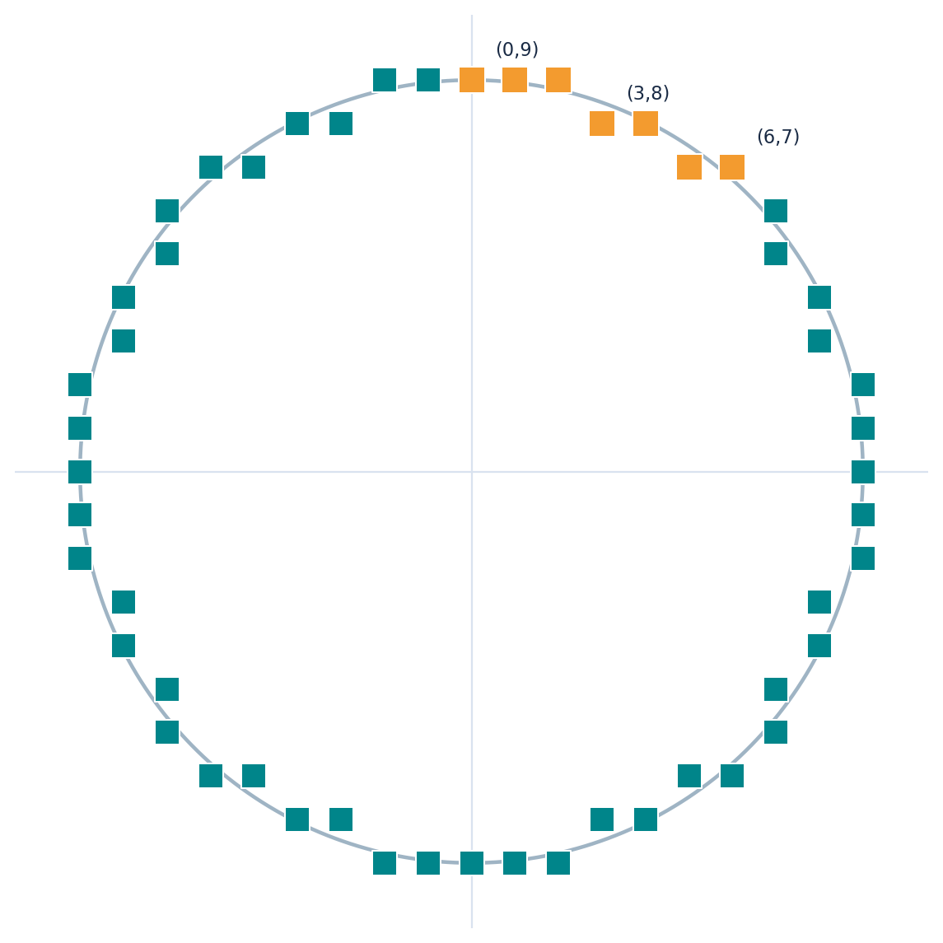
SYMMETRY / R=9 / CSC 4118
Seven calculated points generate the full circle
Use coordinate swaps and sign changes; translate if needed.
LOCAL POINT (3,8)
(3,8) (8,3)
(−3,8) (−8,3)
(−3,−8) (−8,−3)
(3,−8) (8,−3)
One calculation → up to eight pixels
MIDPOINT CIRCLE ALGORITHM • FALL 2026–27
43
Notes:
Orange squares are the seven points calculated in the first octant. Teal squares are the remaining reflections. Explain why some reflected expressions coincide when x=0 or x=y. Say the first octant is computed while x<=y, then the eight possible signed/swapped variations complete the circle. Students often forget (y,x) and the sign patterns. Quiz: from local (3,8), name (8,3), (-3,8), (-8,3), and remaining points.

Slide 44
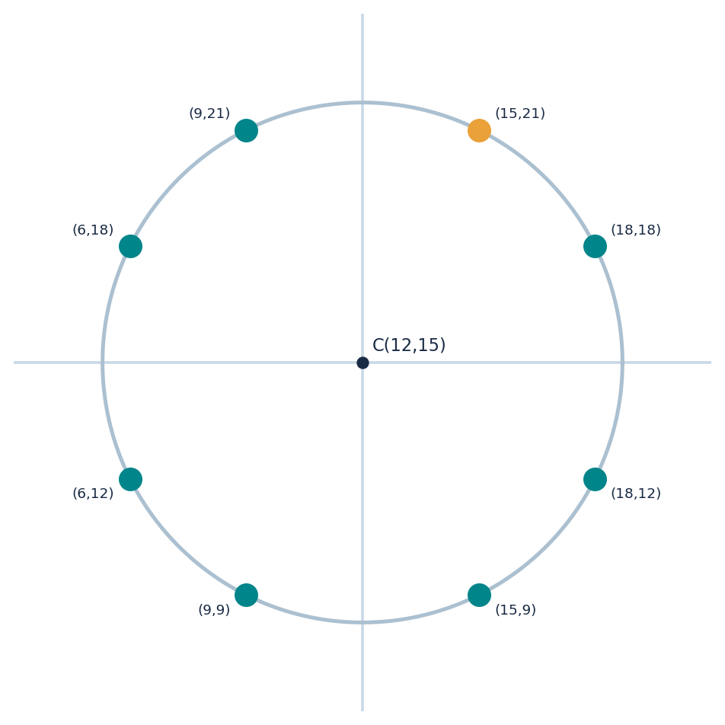
CENTER TRANSLATION / CSC 4118
Move the whole circle to center (12,15)
The midpoint decisions remain local; translation happens when plotting.
TRANSLATE A SYMMETRIC POINT
Local point: (3,6)
Center: (12,15)
Global point: (12+3,15+6)
= (15,21)
Example swap: (6,3) → (18,18)
MIDPOINT CIRCLE ALGORITHM • FALL 2026–27
44
Notes:
Use a radius-7 local point (3,6) from the computed first octant. Apply eight symmetry reflections to obtain local pairs. Add center (12,15) to each pair, for example (3,6)->(15,21), (6,3)->(18,18), (-3,6)->(9,21). The decision parameter does not change with center. The local radius-7 octant has (0,7),(1,7),(2,7),(3,6),(4,6),(5,5). Do not plug absolute centered coordinates into F(x,y) unless you modify the circle equation accordingly.

Slide 45
STUDENT PRACTICE / CSC 4118
Try it independently: radius 11
Solve all pixel decisions before looking at the answer.
QUESTION (10 MARKS)
ANSWER GRID
Center = (0,0), radius r = 11
1. Calculate x₀, y₀ and d₀.
2. For every step, calculate d_new.
3. State E/SE and next coordinates.
4. List the first-octant points.
5. Explain exactly where the algorithm stops.
Step
Old (x,y)
d_old
E or SE
New (x,y)
d_new
MIDPOINT CIRCLE ALGORITHM • FALL 2026–27
45
Notes:
Give students 10-12 minutes for a short mathematical exercise with r=11, center (0,0). Initial d0= -10 but students should calculate it. Require a full row for each iteration: current x,y, d_old, selected E/SE, delta arithmetic, new coordinates, d_new. Require a correctly stated stopping condition. Then compare with the answer in the next slide. Hint only after three minutes: plot before moving.

Slide 46
INSTRUCTOR ANSWER KEY / CSC 4118
Radius 11: verified decision-by-decision answer
Check the two consecutive SE choices around d = 0.
Step | Current (x,y) | d_old | E / SE | Next (x,y) | d_new
1 | (0,11) | -10 | E | (1,11) | -7
2 | (1,11) | -7 | E | (2,11) | -2
3 | (2,11) | -2 | E | (3,11) | 5
4 | (3,11) | 5 | SE | (4,10) | -6
5 | (4,10) | -6 | E | (5,10) | 5
6 | (5,10) | 5 | SE | (6,9) | 0
7 | (6,9) | 0 | SE | (7,8) | -1
8 | (7,8) | -1 | E | (8,8) | 16
9 | (8,8) | 16 | SE | (9,7) | 21
Last plotted octant point (8,8); next candidate (9,7) crosses the diagonal.
MIDPOINT CIRCLE ALGORITHM • FALL 2026–27
46
Notes:
First-octant pixels radius 11 are (0,11),(1,11),(2,11),(3,11),(4,10),(5,10),(6,9),(7,8),(8,8). There are nine valid plotted octant points. The d_old value equals 0 at current (6,9), so SE moves to (7,8). The last current (8,8) is plotted, then a final step generates (9,7), which is outside x<=y. Use this as the model student solution.

Slide 47
BLACKBOARD CHECKLIST / CSC 4118
Exactly how to solve any Midpoint Circle exam question
Use this six-step recipe and you will not lose your place.
WRITE IN THIS ORDER
SELF CHECK
① Given: center and radius
② Initialize x=0, y=r, d=1−r
③ Plot current point (and reflections)
④ Test d_old: E if negative; else SE
⑤ Compute d_new using old x,y; move
⑥ Carry forward d; stop after x>y
Did x increase by 1?
Did y stay or decrease?
Did d_new carry forward?
Did you stop at 45°?
Did you plot symmetry?
MIDPOINT CIRCLE ALGORITHM • FALL 2026–27
47
Notes:
Tell students: 1. Write center and radius. 2. Write x=0,y=r and d=1-r. 3. Plot octant point and eight symmetry reflections if requested. 4. Check sign of d_old. 5. Compute d_new with OLD x and y, then move coordinates in the selected direction. 6. Copy that d_new to the following row as d_old, and stop when the following current x>y. A quick check is that x increases exactly 1 at each move and y never increases. For a circle centered away from origin, translate only at plot time.

Slide 48
ASSESSMENT / CSC 4118
Short formative quiz — theory + mathematics
Use after the demonstration or as a revision exercise.
Q1 · 4 marks
Derive the initial decision d₀ and explain 5/4 − r vs 1 − r.
Q2 · 4 marks
Write the E and SE update rules using old coordinates.
Q3 · 8 marks
For r = 7, produce a full d_old → choice → d_new table.
Q4 · 4 marks
Given C = (12,15) and local P = (3,6), write all 8 pixels.
MIDPOINT CIRCLE ALGORITHM • FALL 2026–27
48
Notes:
Assessment items and answer guide
Q1 exact d0=1+(r-1/2)^2-r^2=5/4-r; integer-friendly 1-r gives the same branch choices for integer r with this tie rule. Q2 E: dnew=dold+2*xold+3; SE: dnew=dold+2*(xold-yold)+5. Q3 r7: start (0,7), d=-6; trace E to (1,7) d=-3, E to (2,7) d=2, SE to (3,6) d=-3, E to (4,6) d=6, SE to (5,5) d=7, SE next (6,4) stop. Q4 center(12,15), local(3,6): (15,21),(18,18),(9,21),(6,18),(9,9),(6,12),(15,9),(18,12).

Slide 49
RECAP / CSC 4118
Teaching recap: three ideas students must remember
Close with the logic, not just the formula sheet.
01
EIGHT-WAY SYMMETRY
Calculate one octant, reflect to complete the circle.
02
DECISION SIGN
d < 0 → E; d ≥ 0 → SE.
03
CARRY-FORWARD UPDATE
Every d_new becomes the next row’s d_old.
Exit ticket: Why do we stop when x > y?
MIDPOINT CIRCLE ALGORITHM • FALL 2026–27
49
Notes:
Final recap
Ask three rapid oral questions: What does 8-way symmetry save? Which candidate does d<0 choose? Why must d_new be carried to the next iteration? For a final exit ticket, ask why the loop stops after x>y. Correct answer: symmetry makes additional first-octant calculations redundant.

Slide 50
REFERENCES / CSC 4118
Sources and course alignment
Prepared from the uploaded AIUB Computer Graphics teaching materials.
Course-provided sources
AIUB Computer Graphics (Spring 2025–26) course plan — CSC 4118, Weeks 5–6
Chapter 2 (Part 2): Scan Conversion — Bresenham’s Mid Point Circle Algorithm
CG Lab Manual 4: Circle Drawing Algorithm — radius and center input
Additional r = 8 and r = 6 step-by-step teaching examples in this deck
Instructor note: exact d₀ = 5/4 − r from lab manual; integer d₀ = 1 − r from theory slides.
MIDPOINT CIRCLE ALGORITHM • FALL 2026–27
50
Notes:
Source provenance
The supplied AIUB course plan lists Bresenham/Midpoint circle work and OpenGL lab around Weeks 5 and 6. The original Chapter 2 Part 2 lecture has older course code CSC 3224 on its title; the current uploaded course plan says CSC 4118, used in this Fall deck. The lecture’s algorithm has d0=1-r and E/SE rules, while the CG Lab Manual 4 gives the exact midpoint initialization p0=5/4-r. This presentation retains those conventions and explains the relationship. Examples r8 and r6 are supplementary teaching calculations, not presented as source-slide examples.

